Slide 1
Writing Readable Code
Style & Structure

Slide 2
Learning Objectives
Practice reading and understanding code.
Understand how we can use comments, variable names and consistent formatting to improve readability of our code.
Be aware of style guides (i.e. PEP8).

Slide 3
Reading and Understanding Code
Most of the code you’ve written so far has been from scratch (i.e. you’ve started with a blank text editor).
In practice, much of the code you write will be adding to an existing code base.
You may be working with somebody else.
You may be adding a new feature to some existing code.
You may be changing existing code to be more efficient
You may be correcting code written by an AI tool.
Before you can add to pre-existing code, you need to understand what it does, and how it works.
Let’s practice reading some code.

Slide 4
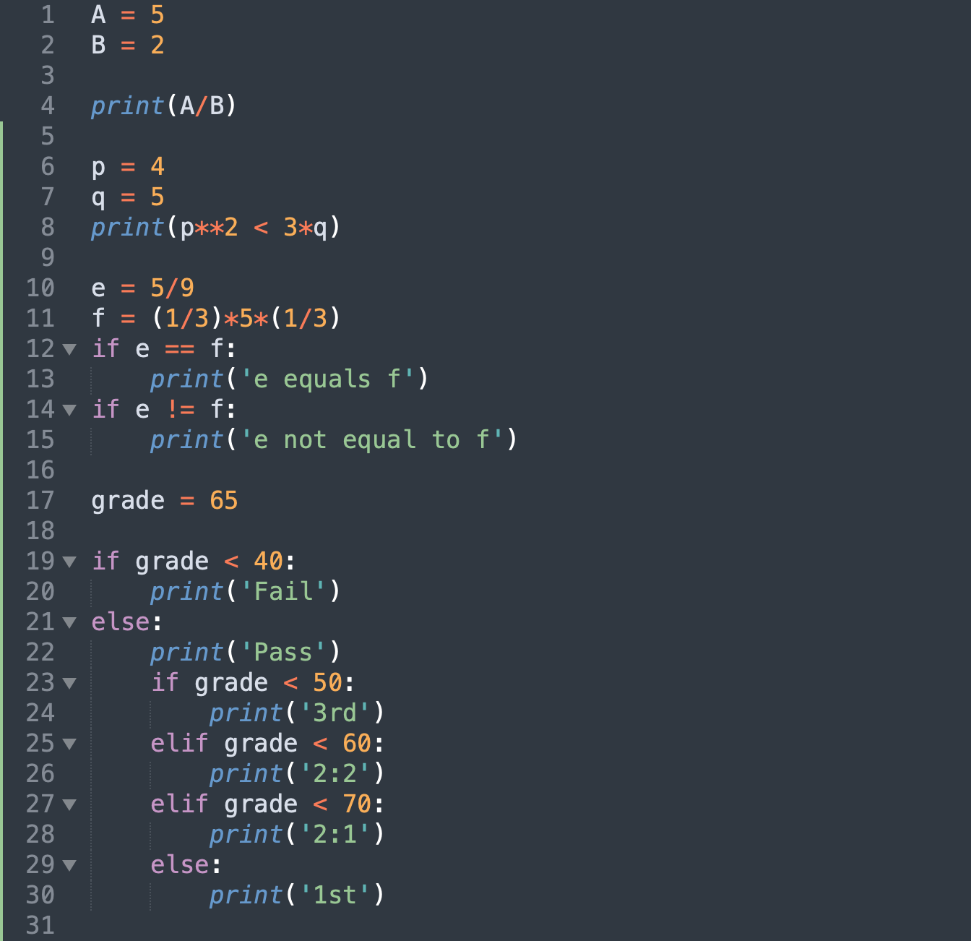
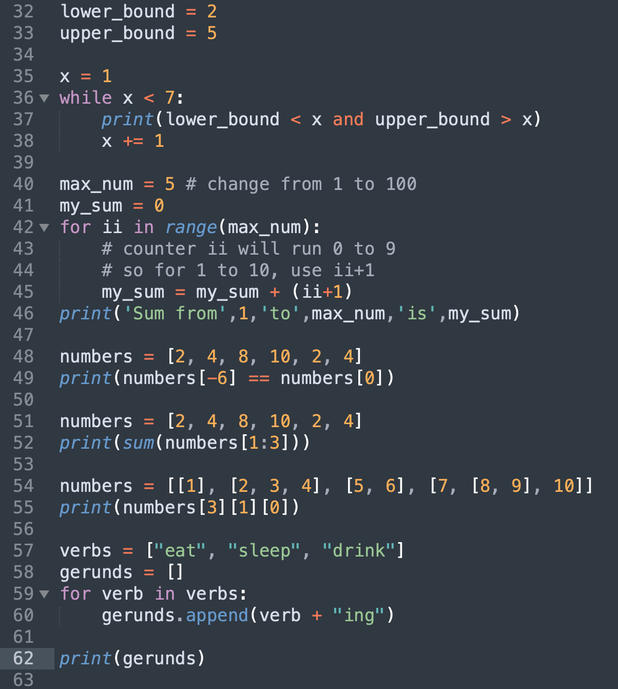
Reading Code Examples 1
1
2
3

Slide 5
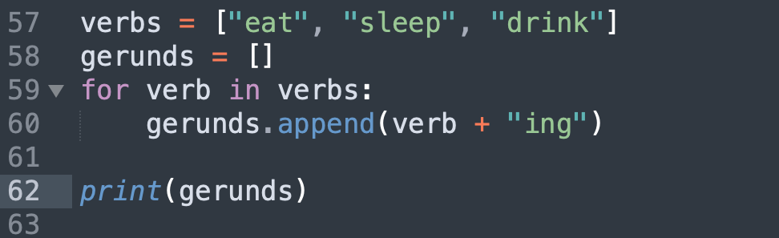
Reading Code Examples 2
4
6
5

Slide 6
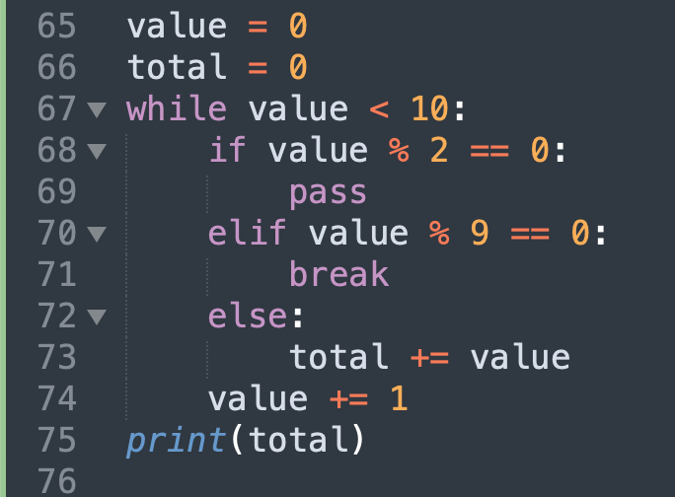
Reading Code Examples

Slide 7
Reading Code Examples
Program counter: 65
Value
0
Int

Slide 8
Reading Code Examples
Program counter: 66
Value
0
Int
Total
0
Int

Slide 9
Reading Code Examples
Program counter: 67
Value
0
Int
Total
0
Int

Slide 10
Reading Code Examples
Program counter: 68
Value
0
Int
Total
0
Int

Slide 11
Reading Code Examples
Program counter: 74
Value
1
Int
Total
0
Int

Slide 12
Reading Code Examples
Program counter: 67
Value
1
Int
Total
0
Int

Slide 13
Reading Code Examples
Program counter: 68
Value
1
Int
Total
0
Int

Slide 14
Reading Code Examples
Program counter: 70
Value
1
Int
Total
0
Int

Slide 15
Reading Code Examples
Program counter: 72
Value
1
Int
Total
0
Int

Slide 16
Reading Code Examples
Program counter: 73
Value
1
Int
Total
1
Int

Slide 17
Reading Code Examples
Program counter: 74
Value
2
Int
Total
1
Int

Slide 18
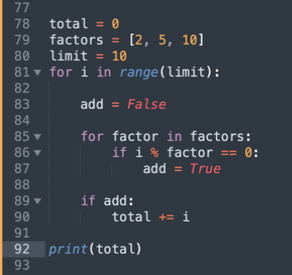
Reading Code Examples

Slide 19
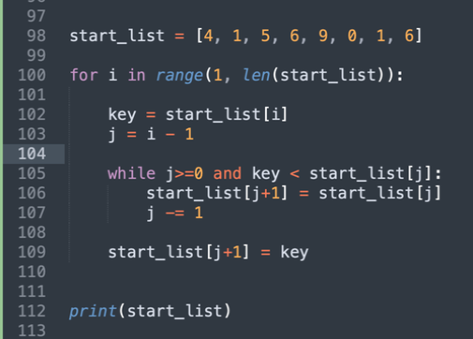
Reading and Understanding Code
For more complex bits of code, you may need to add some print statements to help you understand what’s going on.

Slide 20
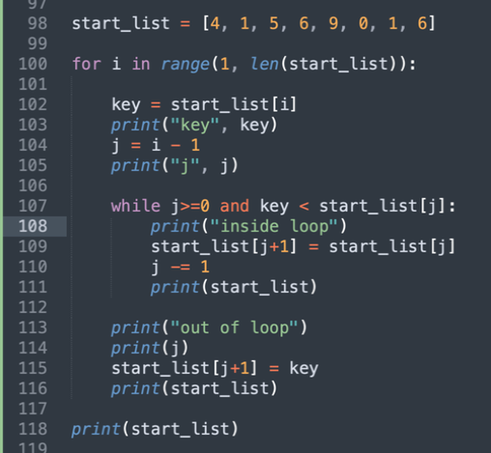
Reading and Understanding Code
For more complex bits of code, you may need to add some print statements to help you understand what’s going on.

Slide 21
Reading and Understanding Code
For more complex bits of code, you may need to add some print statements to help you understand what’s going on.

Slide 22
Writing Readable Code
There are a number of things we can do to make our code easier to read.
Adding comments
Using readable variable names
Using consistent formatting

Slide 23
Writing Readable Code
There are a number of things we can do to make our code easier to read.
Adding comments
Using readable variable names
Using consistent formatting

Slide 24
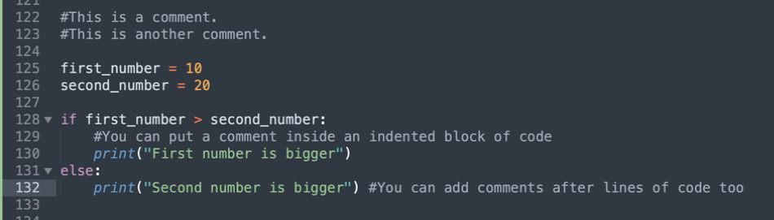
Writing Readable Code - comments
Any line of code that starts with a # will be ignored by the Python interpreter

Slide 25
Writing Readable Code - comments
Any line of code that starts with a # will be ignored by the Python interpreter

Slide 26
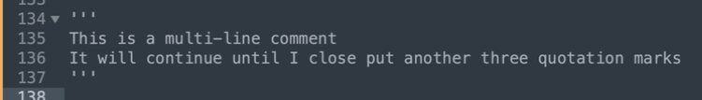
Writing Readable Code - comments
Any line of code that starts with a # will be ignored by the Python interpreter
To create a multi-line comment, use three quotation marks (‘‘‘) instead.

Slide 27
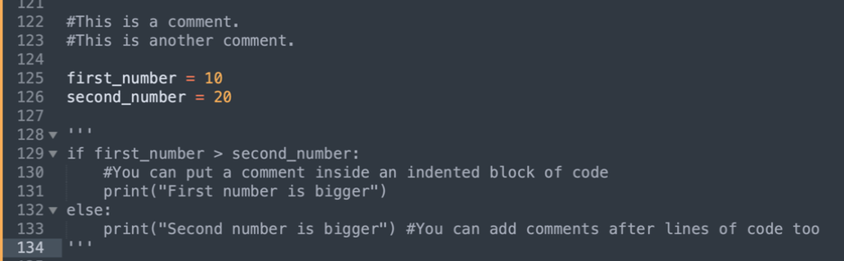
Writing Readable Code - comments
Any line of code that starts with a # will be ignored by the Python interpreter
To create a multi-line comment, use three quotation marks (‘‘‘) instead.
You can also use comments to temporarily remove sections of code that you don’t want to delete- can be really helpful for debugging.

Slide 28
Writing Readable Code - comments
Any line of code that starts with a # will be ignored by the Python interpreter
To create a multi-line comment, use three quotation marks (‘‘‘) instead.
You can also use comments to temporarily remove sections of code that you don’t want to delete- can be really helpful for debugging.
There’s a balance to writing good comments that will come with practice- for now, try to write comments to explain anything that would help “future you”

Slide 29
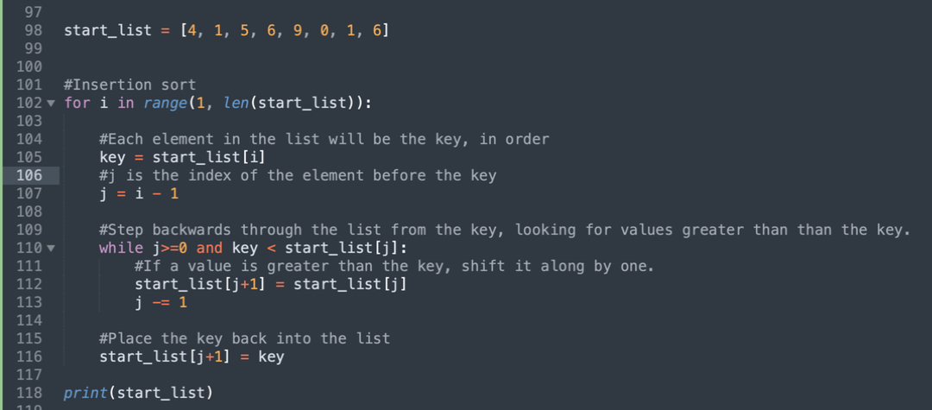
Writing Readable Code - comments

Slide 30
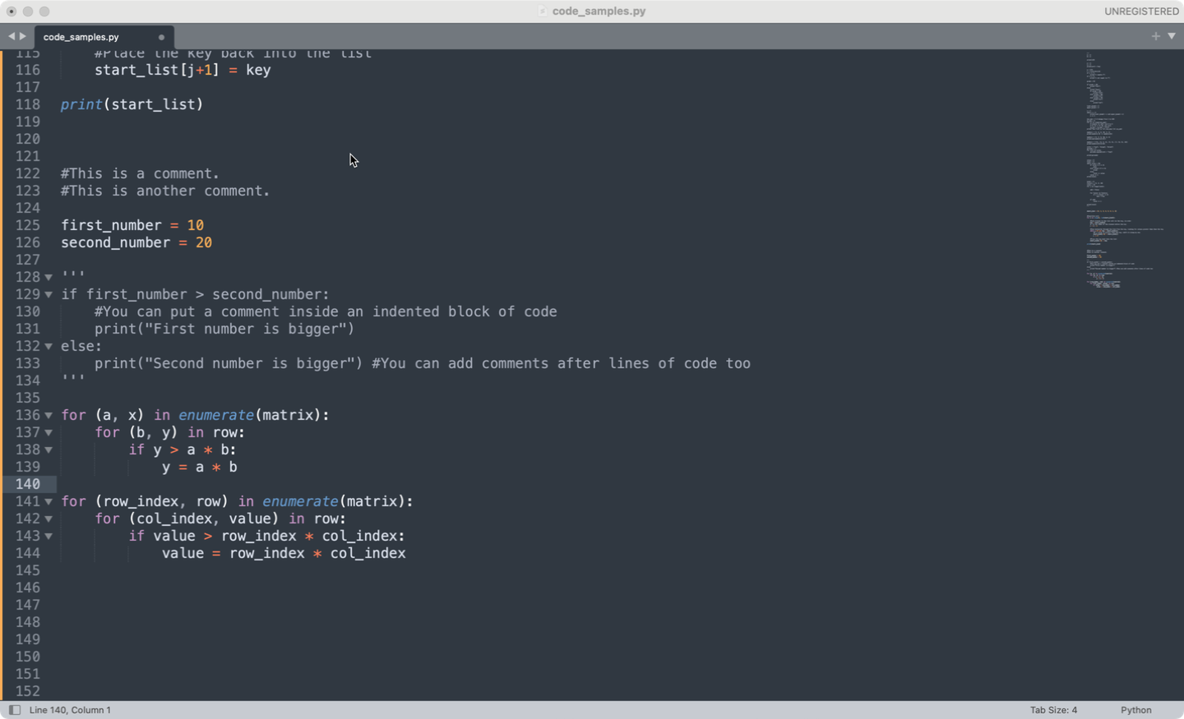
Writing Readable Code – variable names
Variable names should be meaningful and readable
Don’t use single letters like x, y, z
Do use English grammar conventions – i.e. plurals for lists
Do not use Python built-in objects / functions (i.e str, int)

Slide 31
Writing Readable Code – variable names
Variable names should be meaningful and readable
Don’t use single letters like x, y, z
Do use English grammar conventions – i.e. plurals for lists
Do not use Python built-in objects / functions (i.e str, int)

Slide 32
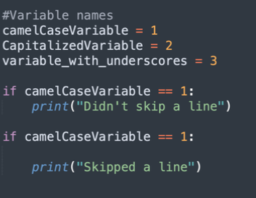
Writing Readable Code - consistency
There’s lots of ways we could choose to write our code

Slide 33
Writing Readable Code - consistency
There’s lots of ways we could choose to format our code
The most important thing is to be consistent- pick a format and stick to it.

Slide 34
Writing Readable Code - consistency
There’s lots of ways we could choose to format our code
The most important thing is to be consistent- pick a format and stick to it.
Python comes with a style guide known as PEP8 – available here
We don’t expect you to follow PEP8 with your code.
But we do expect you to follow a vastly reduced set of style directives – the CPA style guide.
Your assessments will be marked down for not following the unit style guide!

Slide 35
The CPA style guide
Variables should be lower case with underscores (_) to separate words. (this_is_an_example).
Variable names should be meaningful and readable.
Code should use comments to help with readability.
Functions should be lower case with underscores (_) to separate words.
Functions should contain docstrings.
Classes should be use capitalized words (i.e RobotClass).

